Slide 1
Section 4.1 Ratios and Equivalent ratios

Slide 2
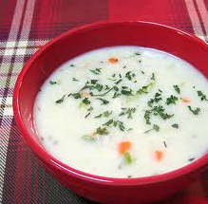
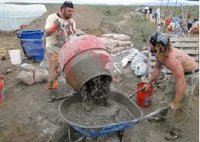
I) Ratios
A comparison of two quantities with the same units
Often used in cooking and recipes when comparing two ingredients
ie: the ratio of flour to water is 1:1 in making cream soup
The ratio of making concrete involves cement, sand and gravel in a definite ratio 1:3:4
A semi-colon is used to separate the two values
Always try to reduce the ratios by dividing by both numbers with any common factors
Ratios can also be written as a fraction:

Slide 3
Two term and Three term Ratios
A two term ratio is used to compare two items
A three term ratio is used to compare “three” items
Ex: Given the following diagram, find the following ratios:
a) Number of Triangles to Circles?
b) Number of blue triangles to all triangles to all shapes
Reduce the ratio to lowest terms
Divide both numbers by 4

Slide 4
Practice: Given each of the following shapes, find the ratios:
a) Happy Faces : Hearts
b) Happy Faces : Hearts: Stars
c) Stars : Yellow Shapes
d) What shapes have a ratio of 1 : 3?

Slide 5
Equivalent Ratios
Two ratios when written as a fraction are equal
Ie: 2 : 3 is equivalent to 4 : 6 and 6 : 9
These fractions are all equivalent because they are equal to 0.6666….
To find equivalent fractions, both the top and bottom must be multiplied by the same number

Slide 6
Challenge: The ratio of girls to boys in a party is 3:5. If there are 56 people in the party, how many boys are there?
There are two ways to solve this problem
1. Find an equivalent fraction where the two numbers add to 56
2. Use Algebra
32 ppl
48 ppl
56 ppl
There are 21 girls and 35 boys in the party
Let “x” be the number of groups of 3 to 5

Slide 7
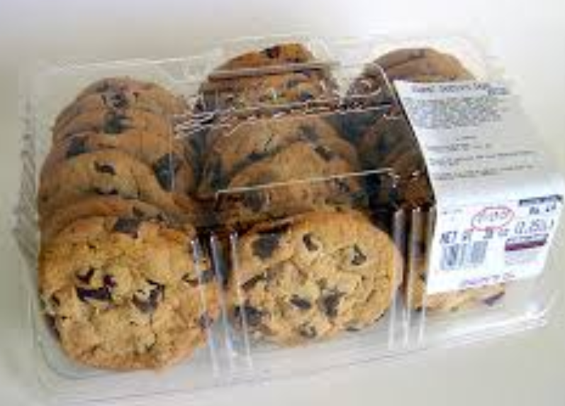
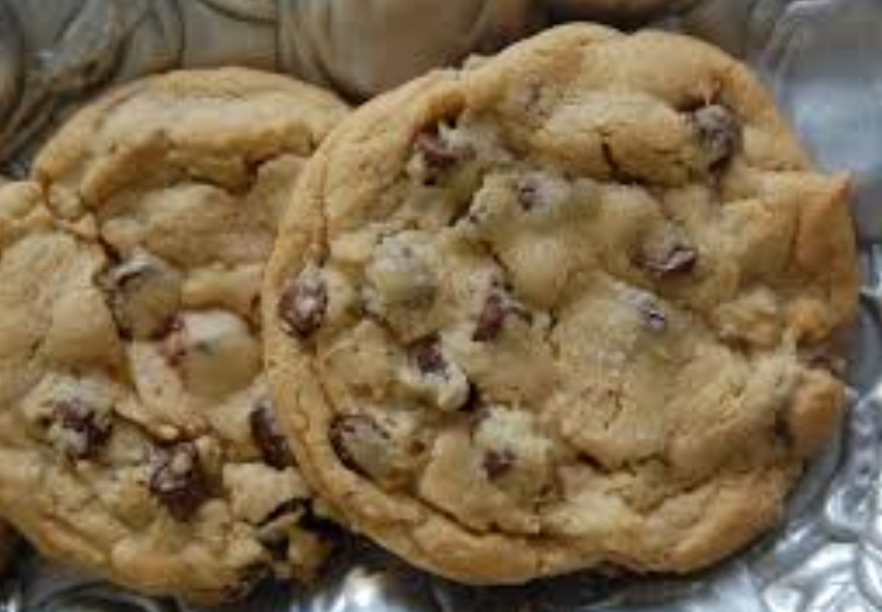
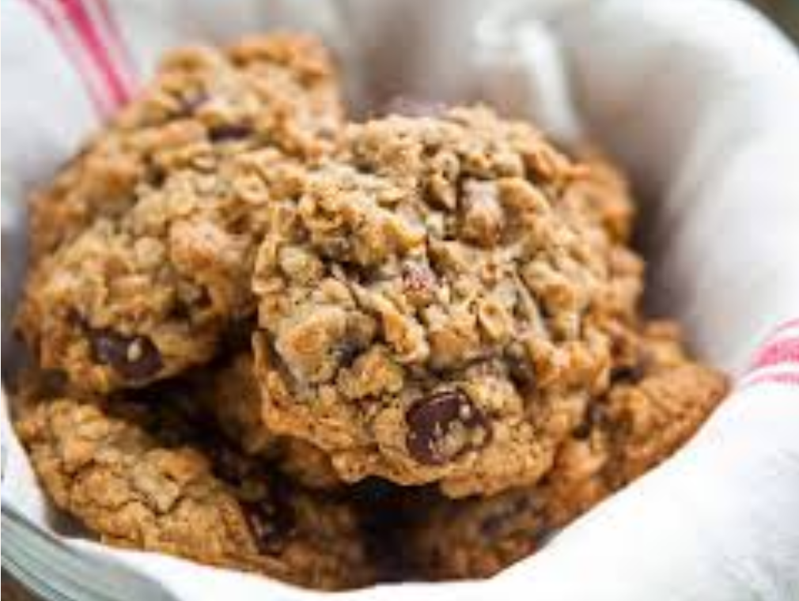
Ex: Cookies at Costco have ratio of 3:7 for raisins to chocolate chips. For cookies at Superstore, the ratio for raisins to chocolate chips is 5:11. Which cookies have a greater ratio of raisins to chocolate chips?

Slide 8
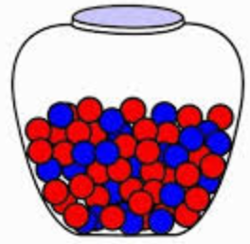
The ratio of red marbles to blue marbles is 2:5. If there are 119 marbles, then how many more blue marbles are there?

